Slide 1
INTERNSHIP REPORT
Jaskeerat singh
(SRM UNIVERSITY)

Slide 2
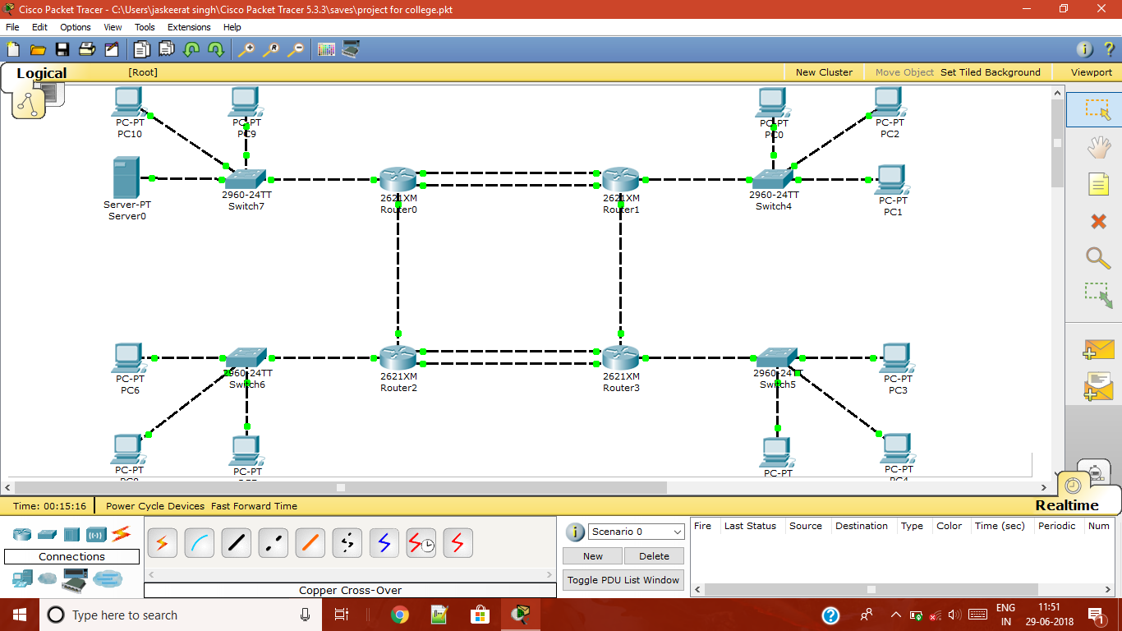
Basic Layout

Slide 3
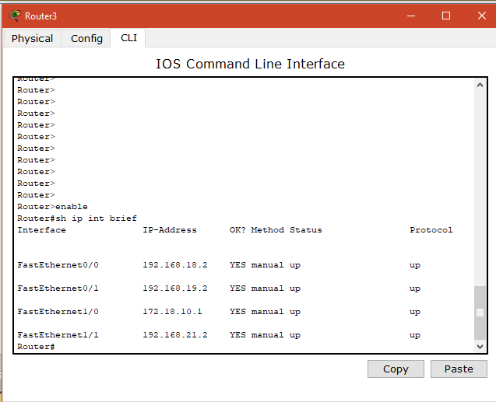
Routers IP

Slide 4
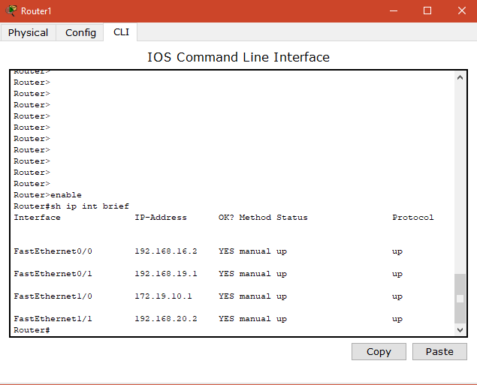

Slide 5
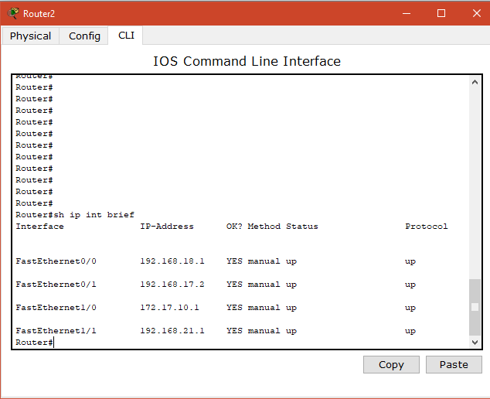

Slide 6
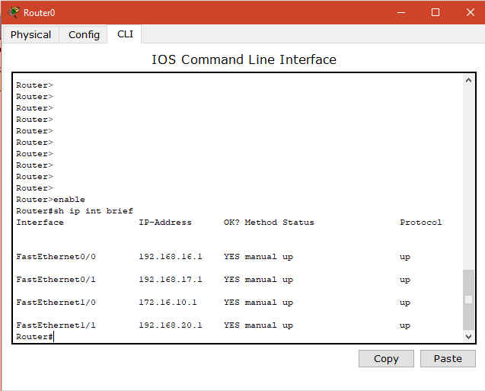

Slide 7
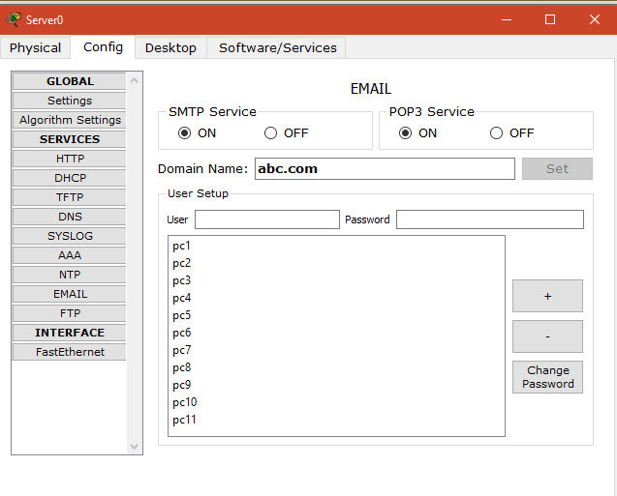
EMAIL Config

Slide 8
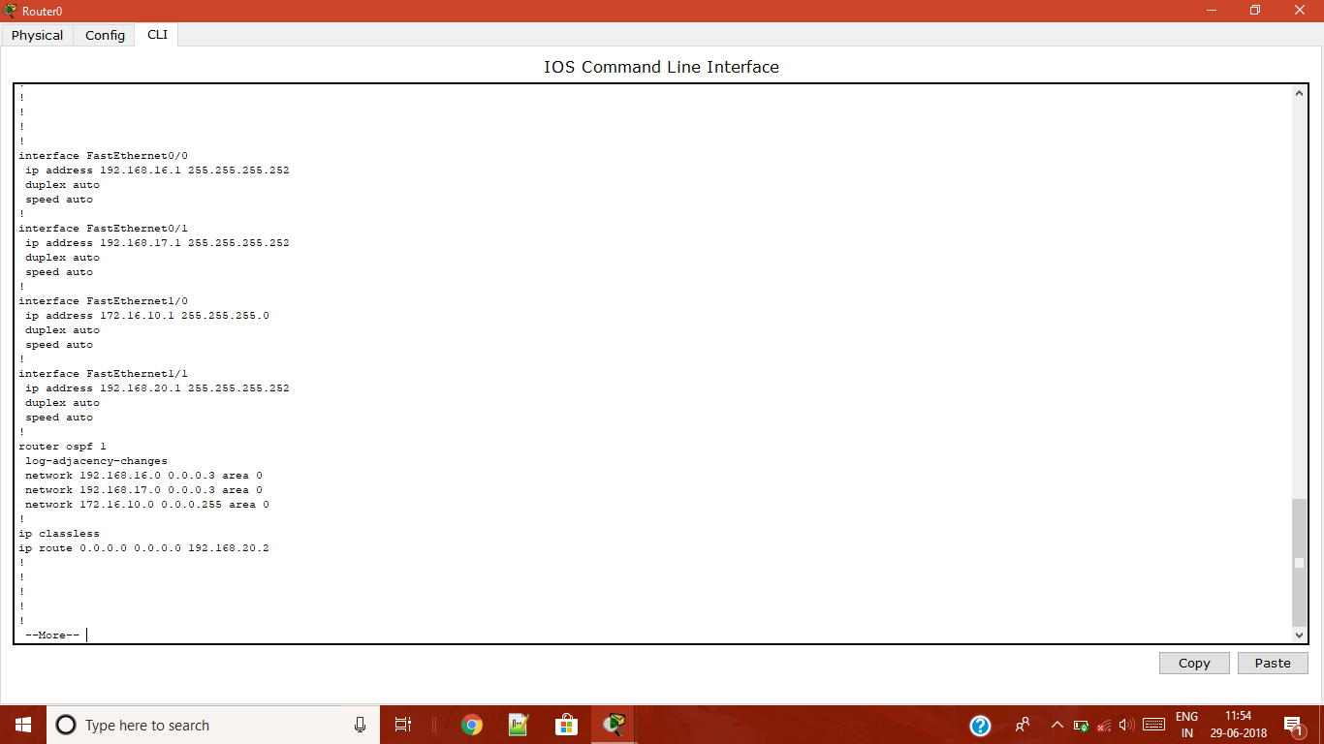
Running Config(Router 1)

Slide 9

Running Config(Router 2)

Slide 10

Running Config(Router 3)

Slide 11

Running Config(Router 4)

Slide 12
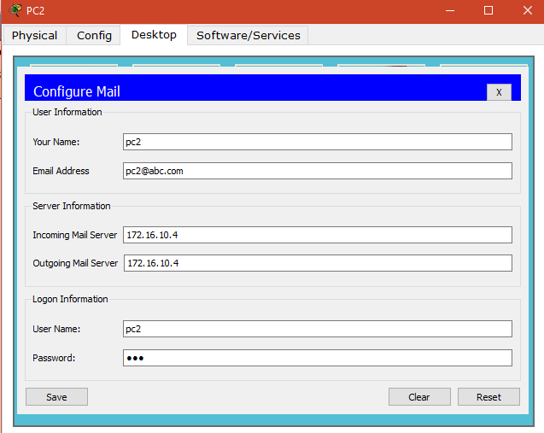
USER CONFIG

Slide 13
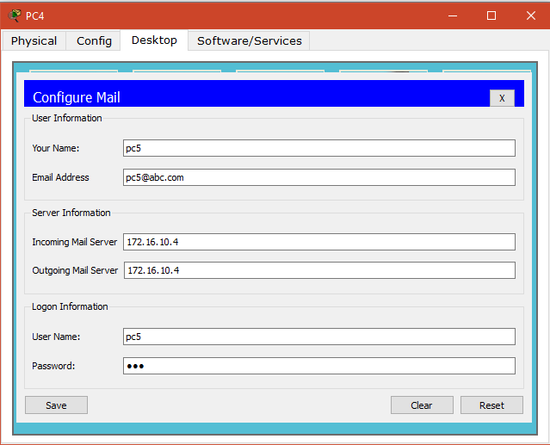

Slide 14
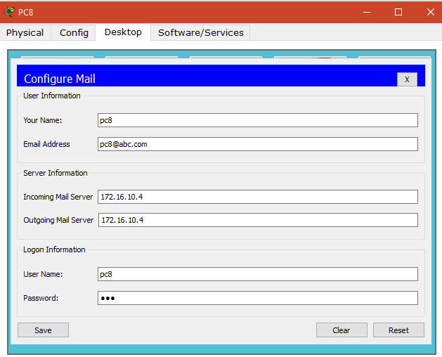

Slide 15
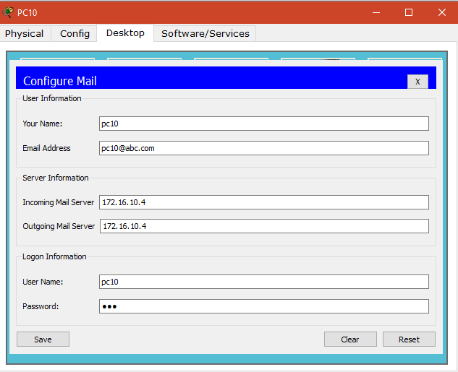

Slide 16
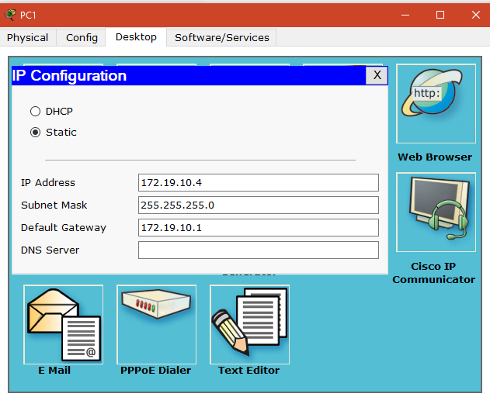
USER PC IP CONFIG

Slide 17
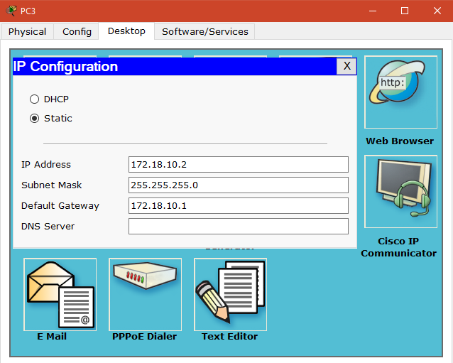

Slide 18


Slide 19
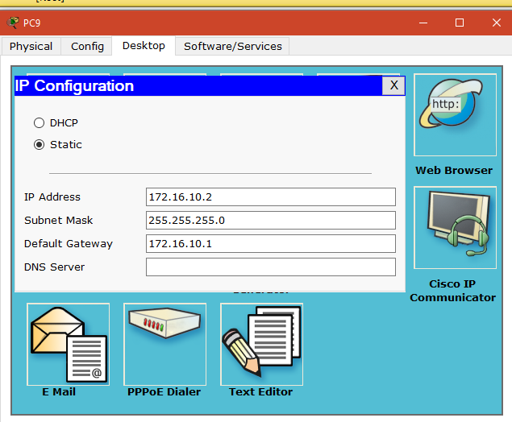

Slide 20
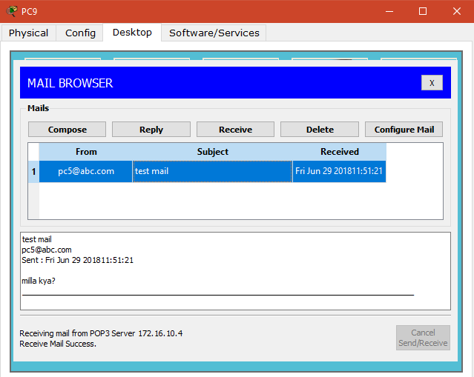
SampleOutputs

Slide 21
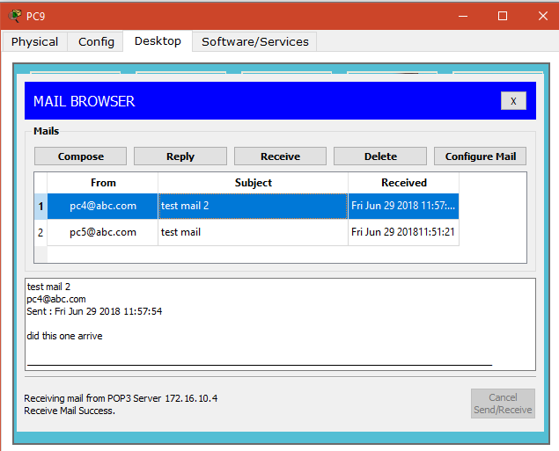

Slide 22
